Slide 1
In-situ OAM (IOAM)
IETF 100 Hackathon
https://tools.ietf.org/html/draft-ietf-ippm-ioam-data
November 11-12 2017

Slide 2
Team
Aditya Dogra @ Cisco << First time at hackathon and IETF
Kai Lu @Huawei
Manish Kumar (Remote) @ Fire eye << First time at hackathon
Mickey Spiegel @ Barefoot << First time at hackathon
Shwetha Bhandari @ Cisco
Yap Chern Nam @ Temasek Polytechnic

Slide 3
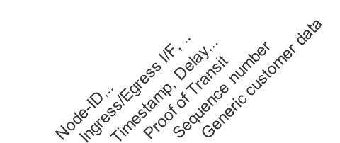
In-situ OAM
IOAM Instr.
IOAM Instr.
Metadata
Metadata
IOAM Instr.
Metadata
Metadata
Metadata
IOAM Instr.
Payload
Metadata
Payload
Payload
Payload
Metadata
Metadata
Metadata
Telemetry UI
Analytics and
Monitoring Engine
IOAM Reports

Slide 4
Benefits of IOAM
Complete network visibility
No black boxes, silent drops and guessing.
Real-time monitoring
No need to depend on polling
Per-packet metadata
No sifting through aggregated counters and information
Full line rate, zero switch CPU involvement
Not limited by control plane bandwidth
https://tools.ietf.org/html/draft-ietf-ippm-ioam-data
https://tools.ietf.org/html/draft-brockners-ioam-vxlan-gpe
https://tools.ietf.org/html/draft-brockners-inband-oam-transport

Slide 5
Goals
Encapsulation in multiple protocols
Hardware implementation
Interop between P4 and VPP data plane

Slide 6

Results
IPv6 implementations
P4
VPP
Interop
VXLAN-GPE implementation in P4
Performance tested on Barefoot Tofino

Slide 7


Programmable Forwarding Plane
P4 Program
(switch.p4)
P4 Compiler
P4 Program Dependent APIs
(C-code)
Runtime Configuration, Notifications,
Query
CPU I/F
HW or SW Forwarding Plane
Port 0
Port N

Slide 8
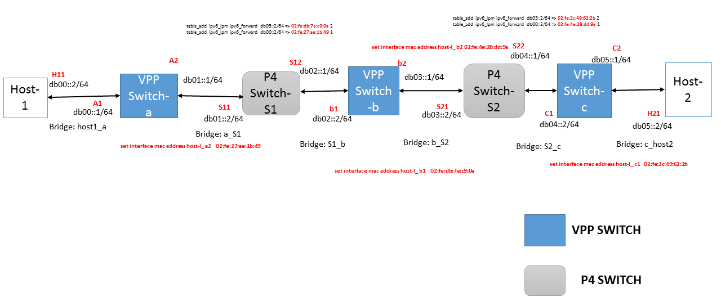
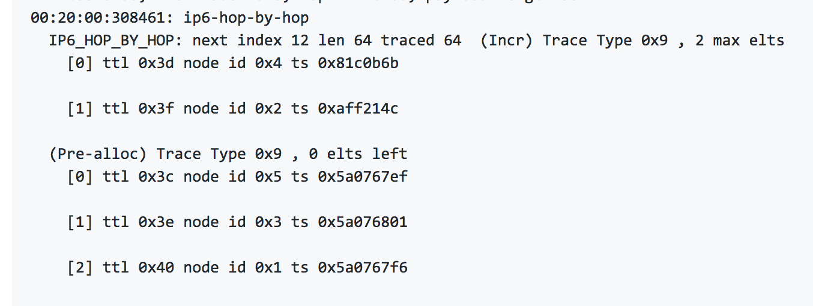
VPP
P4

Slide 9

IOAM Incremental Trace on Barefoot Tofino Switch
Modified existing implementation of P4.org In-band Network Telemetry (INT) spec
Support IOAM data and transport encapsulation formats
Change in p4 code → change in HW behavior → IOAM at 6.5 Tb/s
Barefoot Tofino Switch
(6.5 Tb/s)
100G
Queue
Sender
100G
Receiver
[Enable IOAM]
Add Switch ID, Interface ID, Queue Depth, Ingress Timestamp & Transit Delay to every packet
Collect and visualize Packet headers

Slide 10
###[ Ethernet ]###
dst = 00:11:22:33:44:55
src = 00:77:66:55:44:33
type = IPv4
###[ IP ]###
version = 4L
ihl = 5L
tos = 0x0
len = 160
id = 1
flags =
frag = 0L
ttl = 63
proto = udp
chksum = 0x5d36
src = 10.11.0.1
dst = 10.10.10.1
\options \
###[ UDP ]###
sport = 101
dport = 4790
len = 140
chksum = 0x0
###[ VXLAN_GPE ]###
flags = I+P
reserved1 = 0x0
next_proto= 0x6
vni = 4660
reserved2 = 0x0
[...]
[...]
###[ VXLAN_GPE_IOAM_header ]###
ioam_type = 0x1
length = 0x6
rsvd = 0x0
next_proto= 0x3
###[ IOAM_inc_trace_metadata_header ]###
ioam_trace_bits= 0x8200
node_len = 2L
o = 0L
l = 0L
rsvd = 0L
max_len = 127L
###[ IOAM_hop_info ]###
val = 0x3f111111L
###[ IOAM_hop_info ]###
val = 0x3L
###[ IOAM_hop_info ]###
val = 0x40222222L
###[ IOAM_hop_info ]###
val = 0x5L
[...]
[...]
##[ Ethernet ]###
dst = 00:33:33:33:33:33
src = 00:11:11:11:11:11
type = IPv4
###[ IP ]###
version = 4L
ihl = 5L
tos = 0x0
len = 86
id = 108
flags =
frag = 0L
ttl = 64
proto = tcp
chksum = 0x7431
src = 2.2.2.2
dst = 1.1.1.1
\options \
###[ TCP ]###
sport = 1234
dport = http
seq = 0
ack = 0
dataofs = 5L
reserved = 0L
flags = S
window = 8192
chksum = 0x887a
urgptr = 0
options = []
###[ Raw ]###
load = '\x00\x01\x02\x03\x04\x05\x06\x07\x08\t\n\x0b\x0c\r\x0e\x0f\x10\x11\x12\x13\x14\x15\x16\x17\x18\x19\x1a\x1b\x1c\x1d\x1e\x1f !"#$%&\'()*+,-'

Slide 11
Source code
https://github.com/vpp-dev/vpp.git - ioam-ietf100
P4 program git
Scripts to create p4 simple switch + vpp setup

Slide 12
Feedback on draft-ietf-ippm-ioam-data
Proposed encaps are feasible in both hardware and software implementations
5 issues raised
IOAM-Trace-Type undefined bits: clarify behavior for future compatibility
IOAM Incremental Trace Max Length Definition
Queue ID and Queue Depth
Checksum complement effect on sink nodes?
Transit Delay O bit: Is it really necessary?
Ease of building open source dataplane reference implementation in VPP and P4

